Slide 1
Project Design
Stone Stoned: D.A. Toapanta S2074036

Slide 2
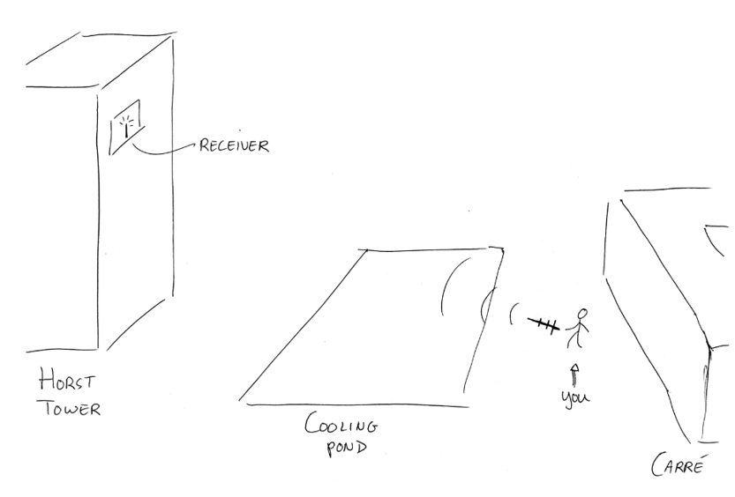
-Apply knowledge of Electrodynamics to build a functional antenna > UHF: 433 MHz > AM Transmitter > High directivity CHOICE: Parabolic Reflector + Dipole
GOAL & REQUIREMENTS

Slide 3
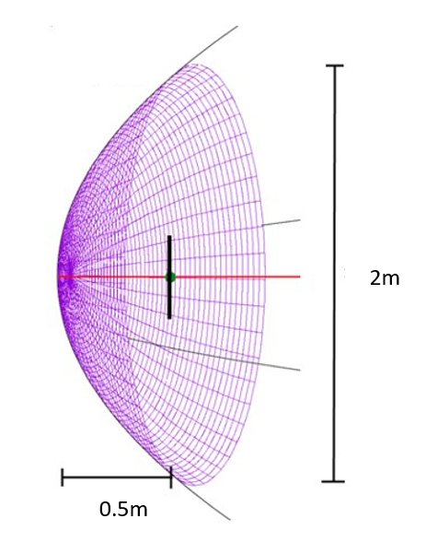

DESIGN
Reflector:
Parabolic dish
Feeder:
Half-wave Dipole
Changes:
Dimensions of the dish
Support for dipole antenna
Inclusion impedance Matching
AM

Slide 4
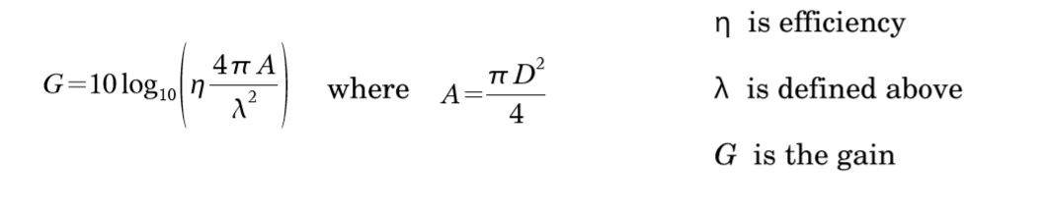
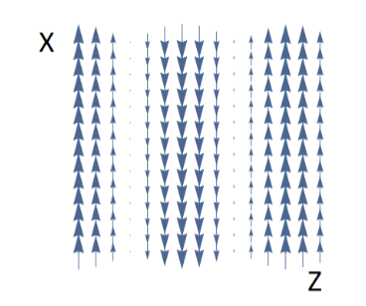
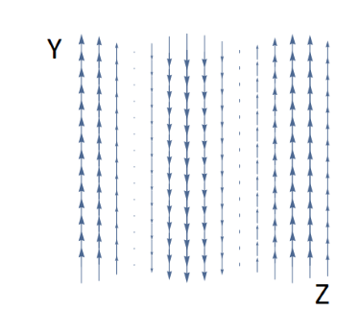
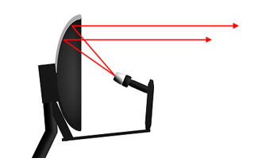


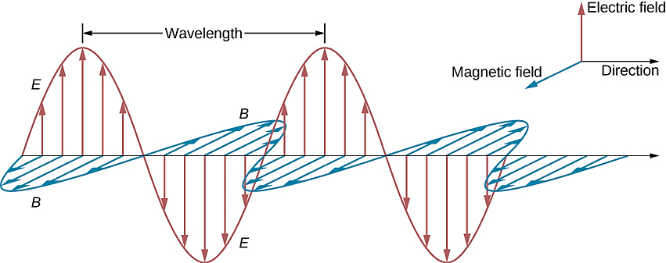
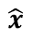
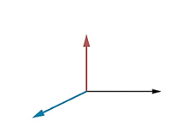
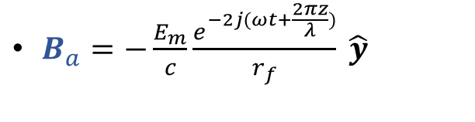
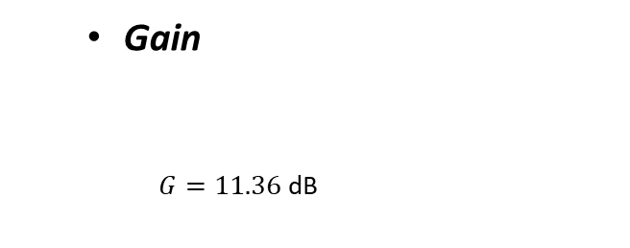
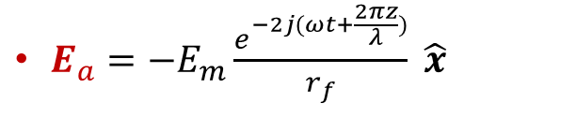
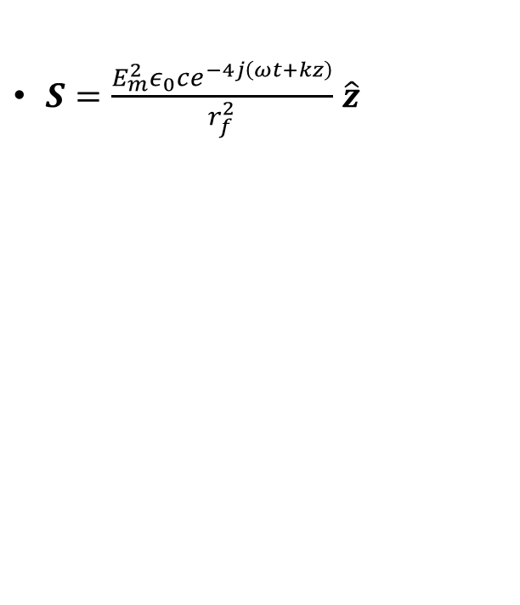
CALCULATIONS[0]
$E_{a}=−E_{m}\frac{e^{−2j(ωt+\frac{2πz}{λ})}}{r_{f}} \hat{x}$
$B_{a}=−\frac{E_{m}}{c}\frac{e^{−2j(ωt+\frac{2πz}{λ})}}{r_{f}} \hat{y}$
Gain
$G=11.36$ dB
$S=\frac{E_{m}^{2}ε_{0}ce^{−4j\left(ωt+kz\right)}}{r_{f}^{2}}$ $\hat{z}$

Slide 5
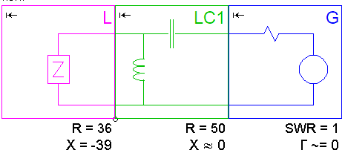
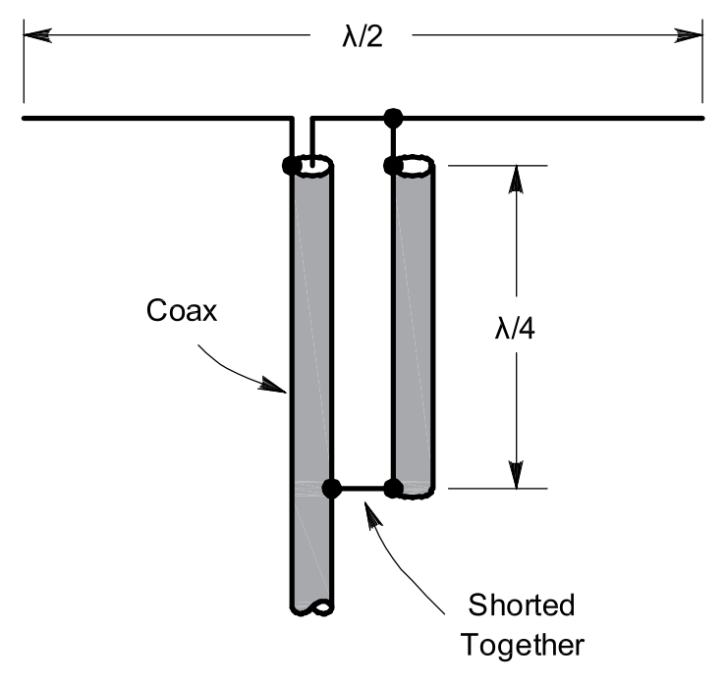
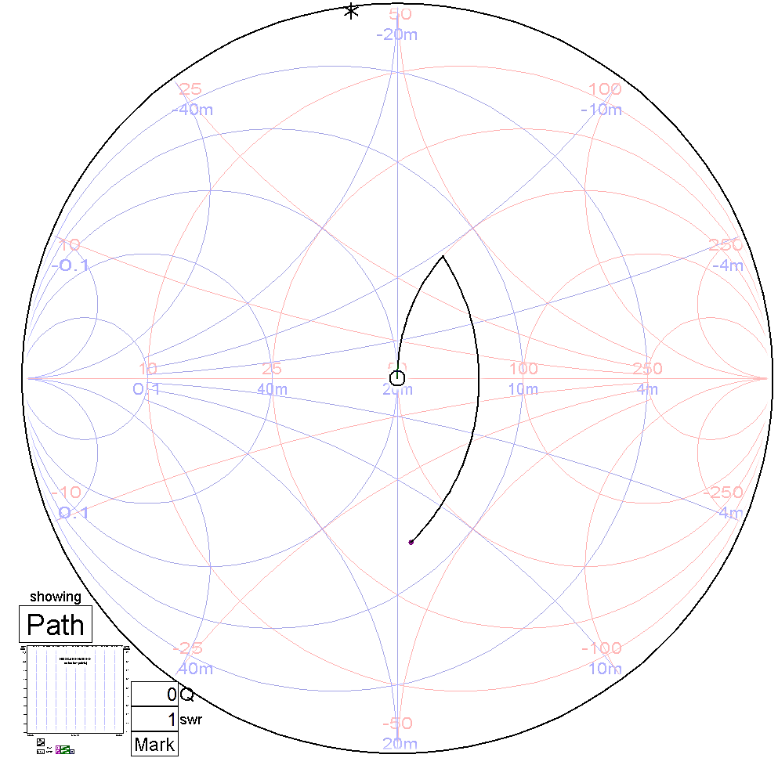
IMPEDANCE MATCHING[3]
Balun sleeve → solve unwanted current
Correct out of phase currents
LC Circuit → counteract reactance
Maximaze SWR 1:1 using Smith Chart
MAXIMUM POWER EFFICENCY
Notes:
The dipole has an impedance which consist of two parts:
The resistance which is the one where all power is radiated and a imaginary part which is responsible for the reactance of the antenna.
To obtain maximum power we need to solve two issues:
Balance the leakage of current due to the nature of the half wave dipole.
Counteract the imaginary part of the antenna. Ideally making it zero.
For the first problem a sleve balun is used. This is nothing else than a quarter length wavelength of coaxial cable soldered to the dipole
For the second issue, a LC circuit is built and soldered between the transmission line and the terminals of the antenna. This solution
creates the complex conjugate of the input impedance of the dipole, thus make it close to zero
While presenting solution for the balun, make it clear in the first picture that current I3(red one) is not desired and that the balun does the job
While presenting solution for the imaginary part, show the value of -38 Xs in the screenshot and that the LC circuit get rid of it.
Good luck!

Slide 6

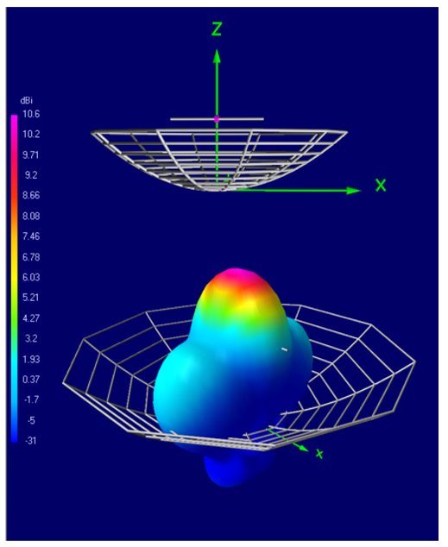
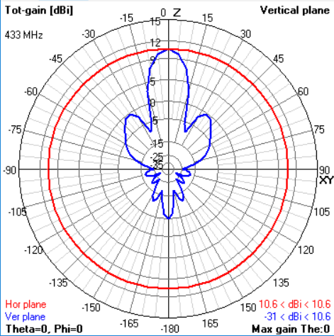
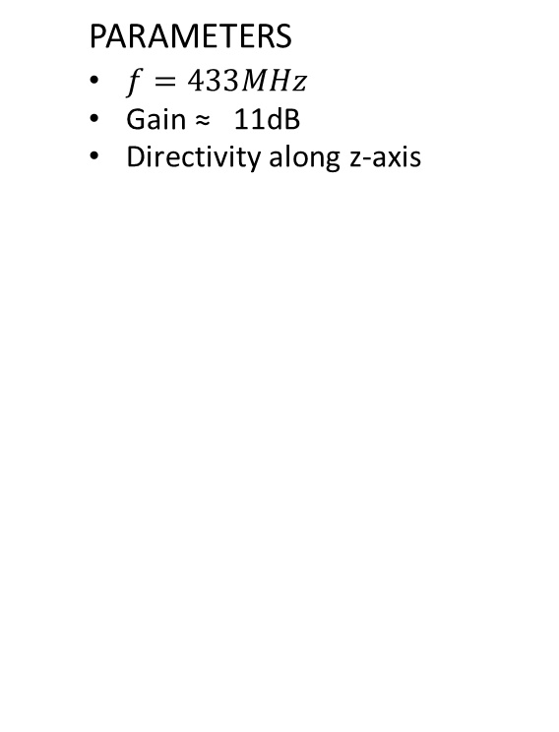
SIMULATIONS [5]
PARAMETERS
$f=433MHz$
Gain ≈ 11dB
Directivity along z-axis

Slide 7
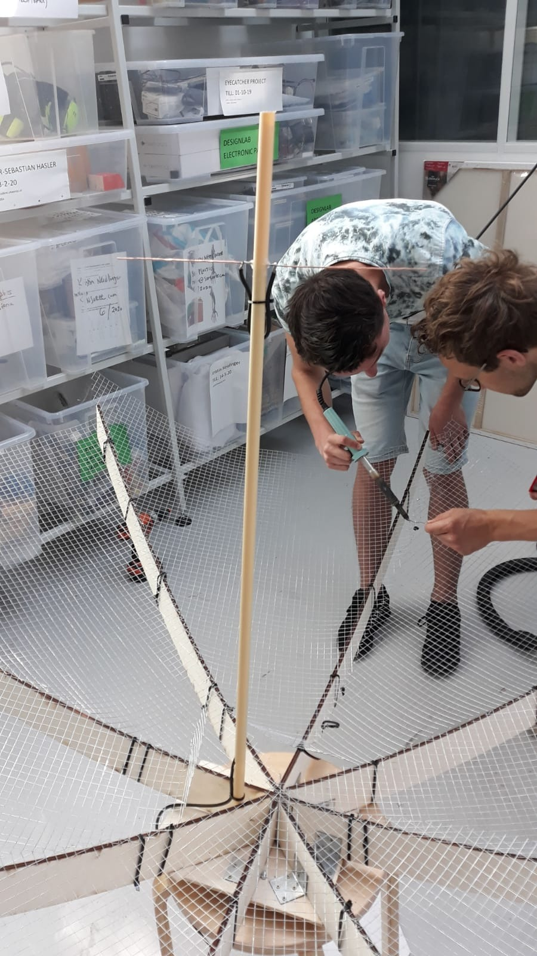
CONSTRUCTION
Length | Material
10mm | PVC Tube
5 m | Mesh Wire
1.20 x 0.70 m | Wood strips
2m | Coper Wire
1m | Coaxial cable
#2 | Hinges
10mm PVC Tube
5m Mesh Wire
1.20 x 70 Wood
2m Coper Wire
1m Coaxial cable
2 Hinges
Tools were lend, some materials recycled
Total spent: € 23.45

Slide 8
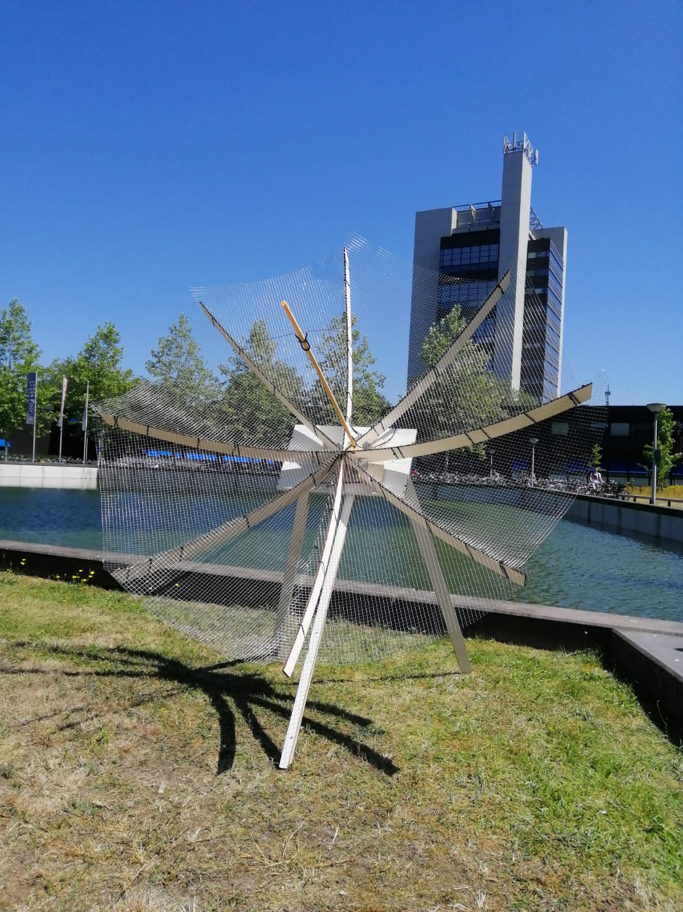
FINAL RESULT
Antenna Works
Directional
Adjustable stand and Light weight
Easy to assemble, and budget friendly
Tested at 433MHz along 200m
Practical

Slide 9
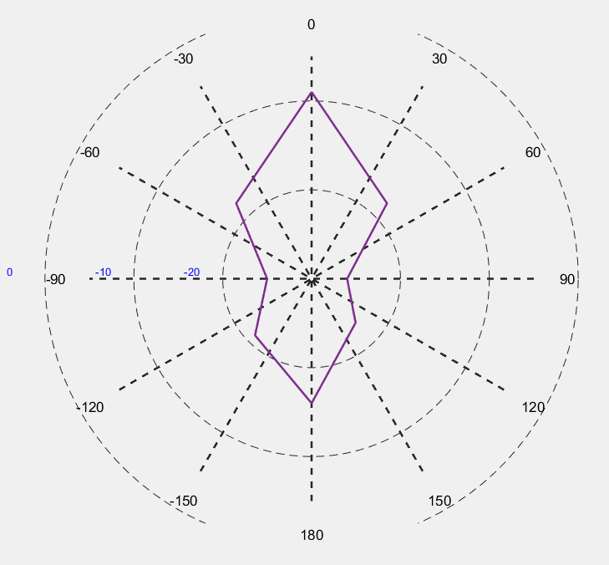
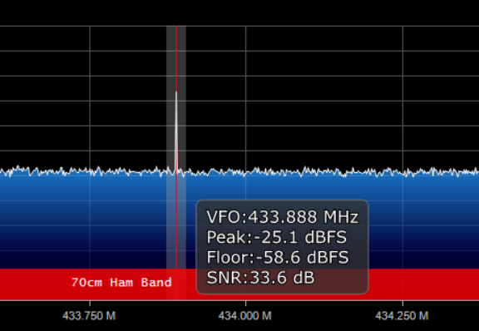
MEASUREMENTS[6]
Measured at the Horsttower, sending from the cooling pond
Measured at 20 meters from the antenna
Notes:
Measured with all the default settings, except the “RF-gain” which was set at 28dB

Slide 10
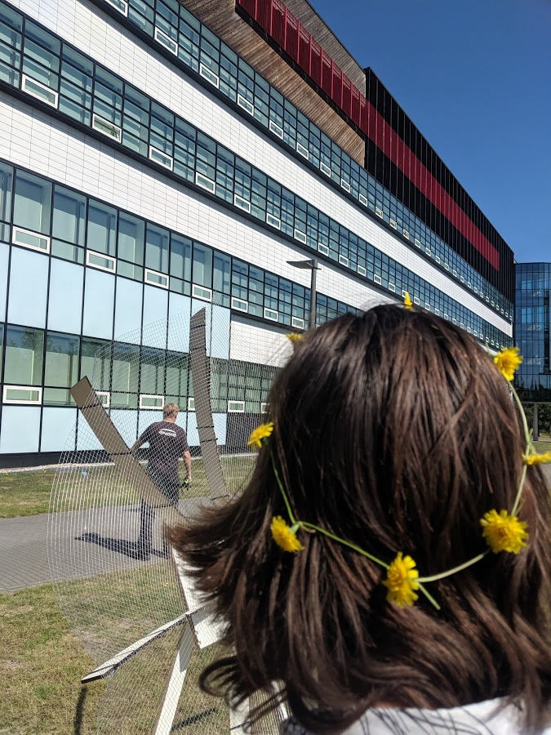
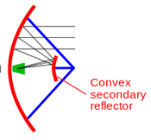
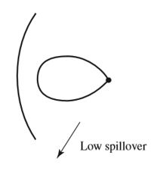
WHAT WE LEARN / IMPROVEMENTS
-Relocate Focal point to the back of the dish
- Dipole feed + horn to avoid spillover
- Mesh wire still works but try aluminium

Slide 11
Bibliography
[0] Richard Feynman, The Feynman Lectures. Caltech, 2013 http://www.feynmanlectures.caltech.edu/index.html
[1] Last accessed: (15 Jun 2019). Available at: https://en.wikipedia.org/wiki/Five_hundred_meter_Aperture_Spherical_Telescope
[2] Last accessed: (17 Jun 2019) Available at: http://markgridantenna.com/wp-content/uploads/2015/12/360-400-Grid-151015.R1.pdf
[3] Constantine A. Balanis, Antenna Theory: Analysis and Design. Wiley, 2016
[4] Warren L. Stutzman, Gary A. Thiele. Antenna Theory and Design, 3rd Edition, 2012
[5] 4NEC2 program
[6] VNA analyzer, Airspy program

